Slide 1

DriverPass System Analysis
Travis London
Notes:
[No speaker notes required for this slide.]

Slide 2

System Requirements
Functional:
Users have access to practice tests.
Users can schedule driving lessons.
Non-Functional:
Users will need a case sensitive password and a unique username when logging in.
Cloud web application.
Notes:
The system allows the user to have access to taking the practice tests. The system will allow the user to see all progress of the practice tests.
The system will allow the user the ability to schedule driving lessons. The system will provide an up to date calendar allowing the customer to schedule driving lessons, provide driving lesson appointments that contains available times and avoid the calendar from showing overlapping driving lesson appointments.
The system will validate users when they are logging in. The system will check the case sensitive passwords and unique username of the users and make sure they are correct by matching what the user inputted and what the system has stored for the user.

Slide 3
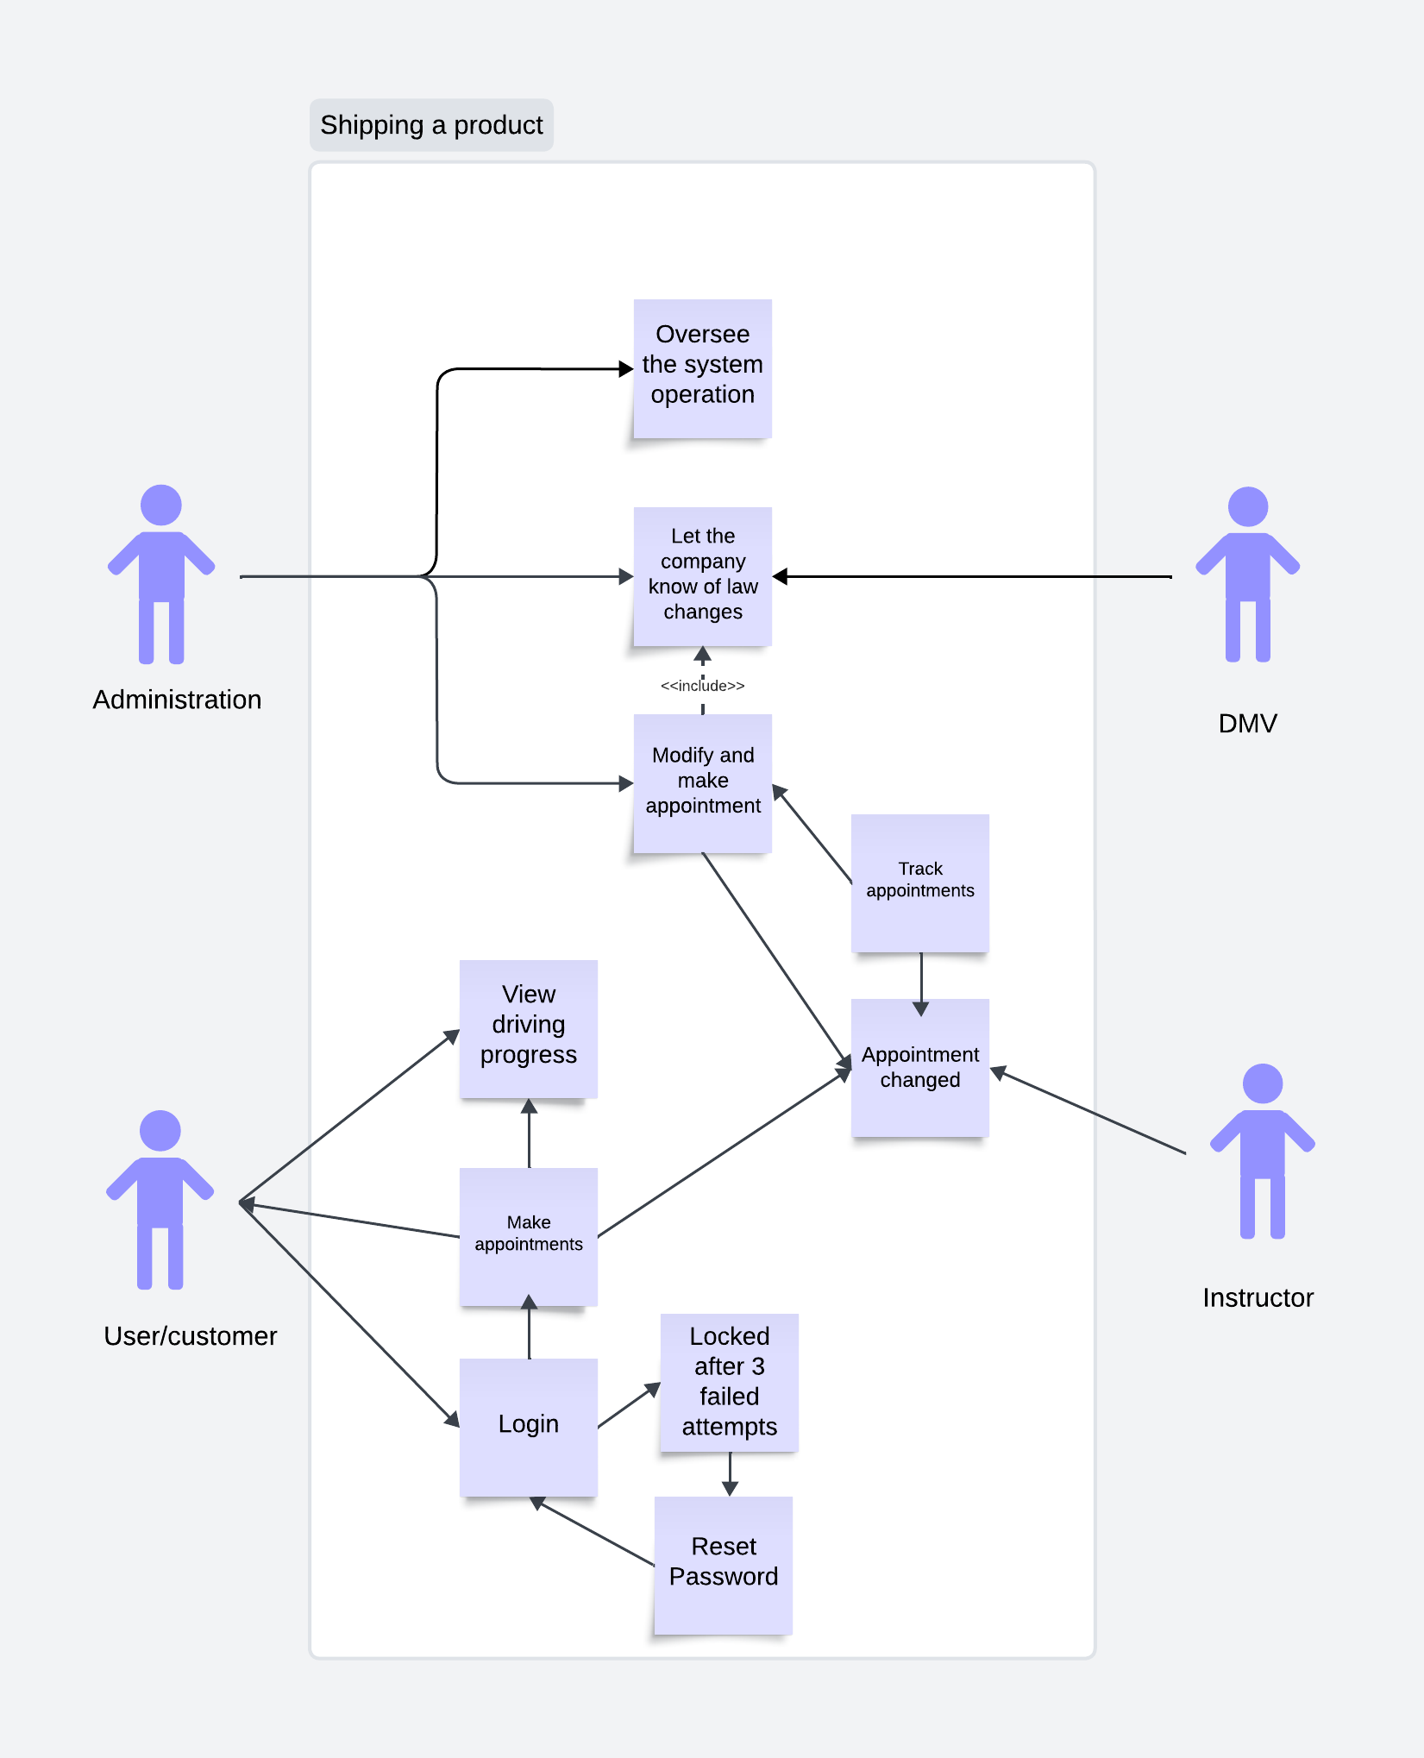
Use Case Diagram
Notes:
The users for the system are the admin, the customer, the DMV and the instructor. For the diagram the user can either make or modify the appointments, the system will then track the appointments, for the administration they can supervise the system operations, the user will be able to view the appointment schedule and the users can log in. For DriverPass the users will have the necessity to reset their own passwords also the IT office will be given the ability to reset the user password as well. For user/customer they will need to be able to see their training progress and view any other training that’s available. Instructor needs to see the users progress and be able to access their profiles. For the DMV they will notify the company of any changes to the law.

Slide 4
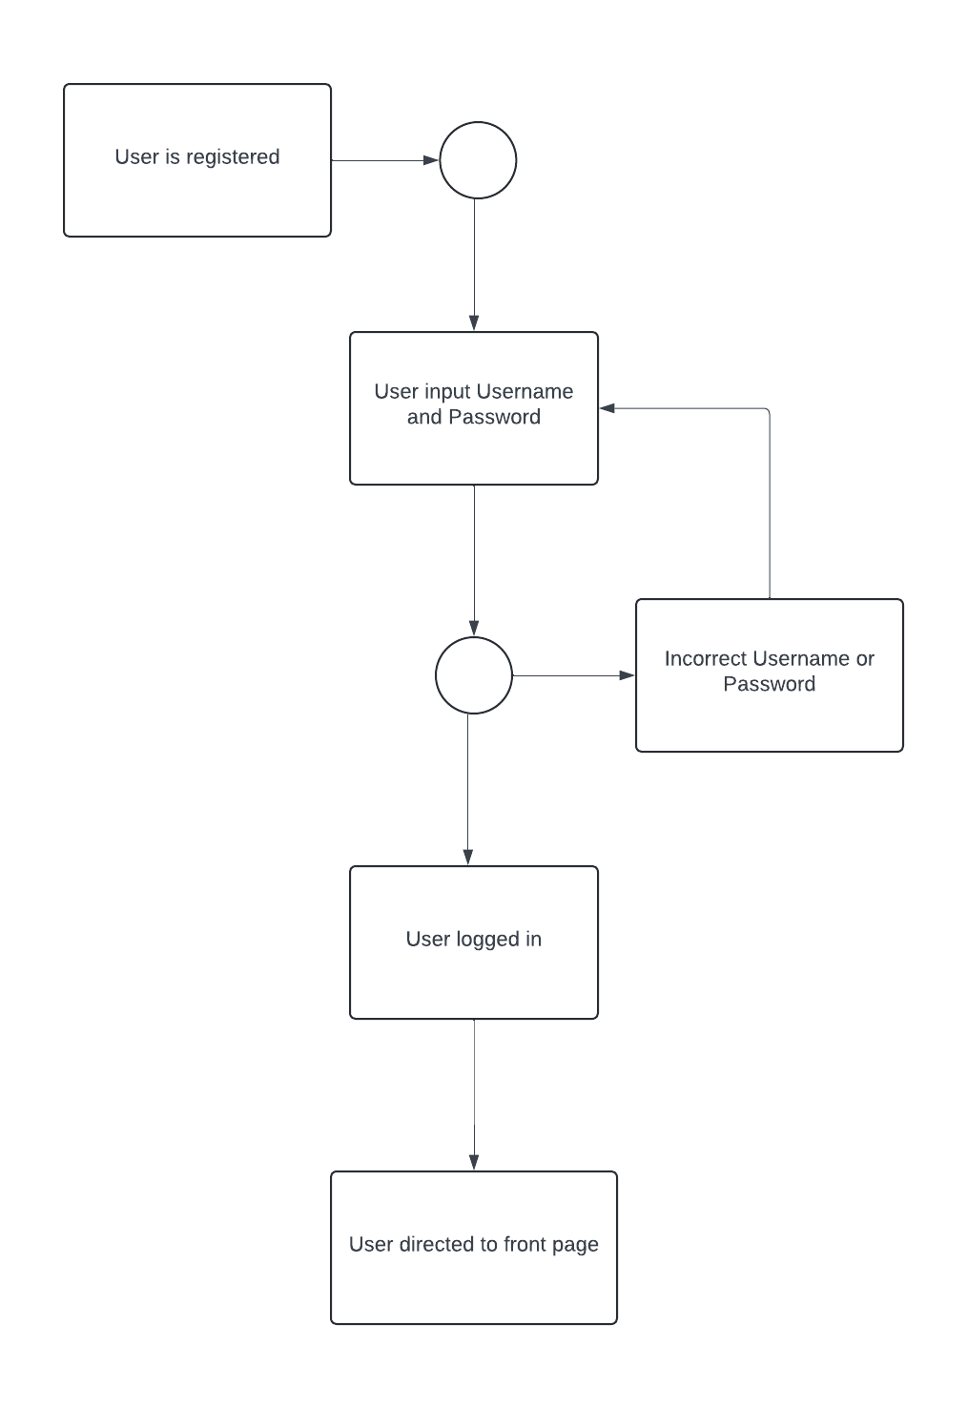
Activity Diagram
Notes:
The diagram explains the user log in. The user will need to enter their username and password that is created for each person. Once the user enters the username and password accurately the user will be sent to the homepage. If the username or password was inaccurate the process will end and the user will have to input the username and password. If the username and password have to be reset, once the username is correct the system will then ask the user to input their email address. If the email is not correct it will then ask the user again. Once the email is correct a link will be sent to the email for the user to reset the password. If the user didn’t receive the email with the link they would have to contact the IT department to reset password. Once the user reset the password they get a notification that the password has been reset.

Slide 5
Security
Passwords and Username will require case sensitivity.
After three failed log in attempts Users will be locked out of their account.
All Usernames and passwords will be placed in an encrypted database.
Administration and IT can remove and modify a Users if any security threat is present.
Notes:
The important part of the system design is security. For security we have to make sure it goes past the username and password. If a user account has failed the log in attempt part of security is to lock the user out their account. Users will have the ability to reset their passwords or contact the IT team to reset the users password. Doing this will ensure the data integrity and the security connection between the system and the users.

Slide 6
System Limitations
The DMV website interface may not function properly.
Time frame for the project will take 5 months to finish the project
The system will be a web based and might not include a mobile version for the users.
The users won’t be able to pick the driver they want to be paired with.
All Financial transactions will be handled by a third party and not in house.
Notes:
The design of the system will have some limitations. The project will take five months due to the limitation will require a larger length of time for the project to be completed. For the scope of the project is not known as yet. The system will not be able to work on mobile phone as yet. Having mobile access will have a bigger benefit for DriverPass and for the users. The users won’t be able to choose the drivers they are suitable with. This will be an issue for the user if they can’t select the drivers they want. The system has a couple of limitations but the system decent right and after the limitations are completed the system will be much better.

